Slide 1
C-STORE OFFICE
ADVANCED ACCOUNTING – Credit Card Reconciliation

Slide 2
Agenda
Where do I find Credit Card fees in C-Store?
Two step process to clear credit card fees:
Accounts Receivable – Collect fees
Account Register – Select account to charge the credit card fees to

Slide 3
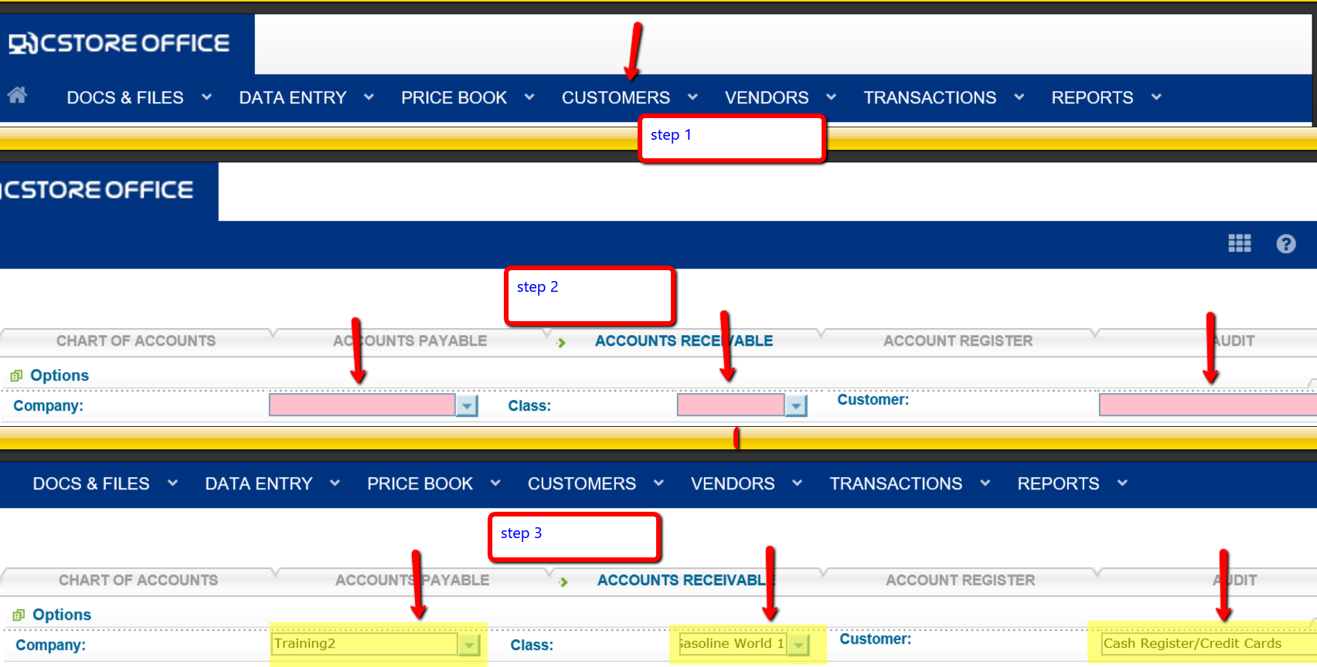
WHERE DO I FIND THE CREDIT CARD FEES IN C-STORE OFFICE

Slide 4
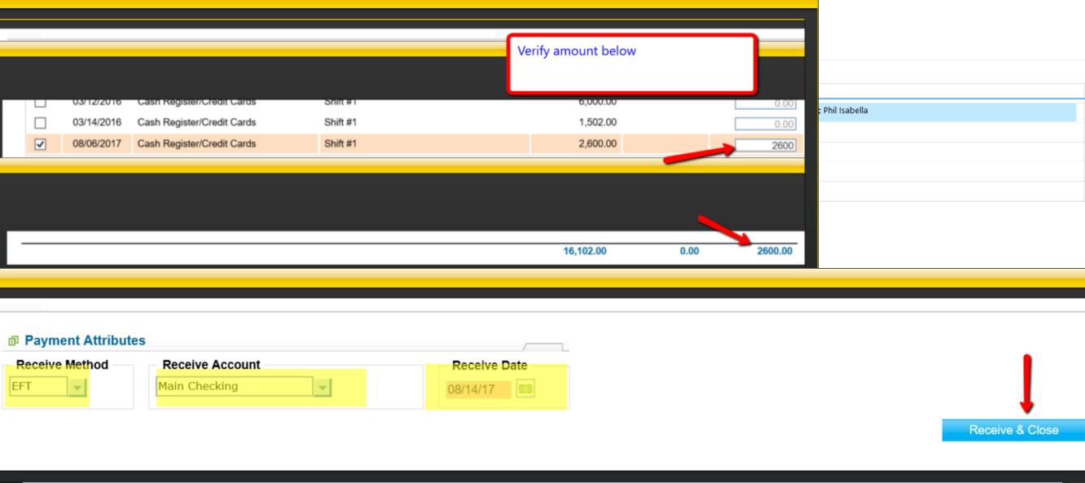
RECEIVING A CREDIT CARD PAYMENT

Slide 5
RECEIVING A CREDIT CARD PAYMENT
* SPECIAL NOTE:
Lets use the example of collecting $2,600.00. You might have 200.00 in credit card fees from the total of $2600.00. Collect the entire amount because we will be making a journal entry to account for the credit card fees.
$2600.00 – IN
$200.00 – OUT – Credit Card Fees

Slide 6
MAKING THE JOURNAL ENTRY

Slide 7
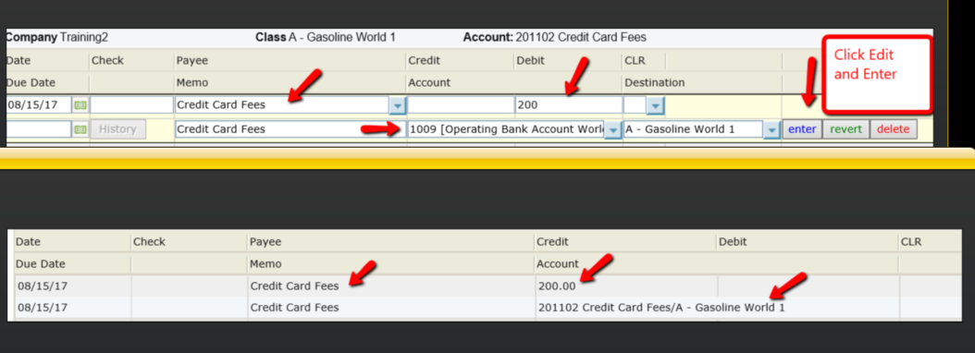
CHECK YOUR ENTRY
Transactions > Account Register > Account (Your Credit Card Fees Account) You will see a debit to Credit Card Fees and a Debit to the 1009 Operating Bank Account to verify you accounted for Credit Card Fees
** Remember to click Edit/Enter and Save and Close (bottom right hand corner) to complete the entry

Slide 8
FUEL INVOICES
The process is the same except you will go into Accounts Payable and pay the invoice as well as the credit card fee ,complete the process by making the journal entry
*** Pay both the invoice and credit card fee

Slide 9
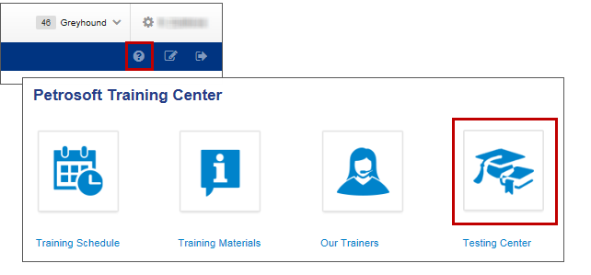
TRAINING CENTER
For additional testing on what you have learned, please refer to our new “Testing Center”.
To access this new feature, click the help icon, and then select Testing Center.

Slide 10
THANK YOU FOR YOUR TIME!
Get in Touch
www.cstoreoffice.com
Petrosoft LLC
290 Bilmar Drive
Pittsburgh, PA 15205
1.412.306.0640

